Slide 1
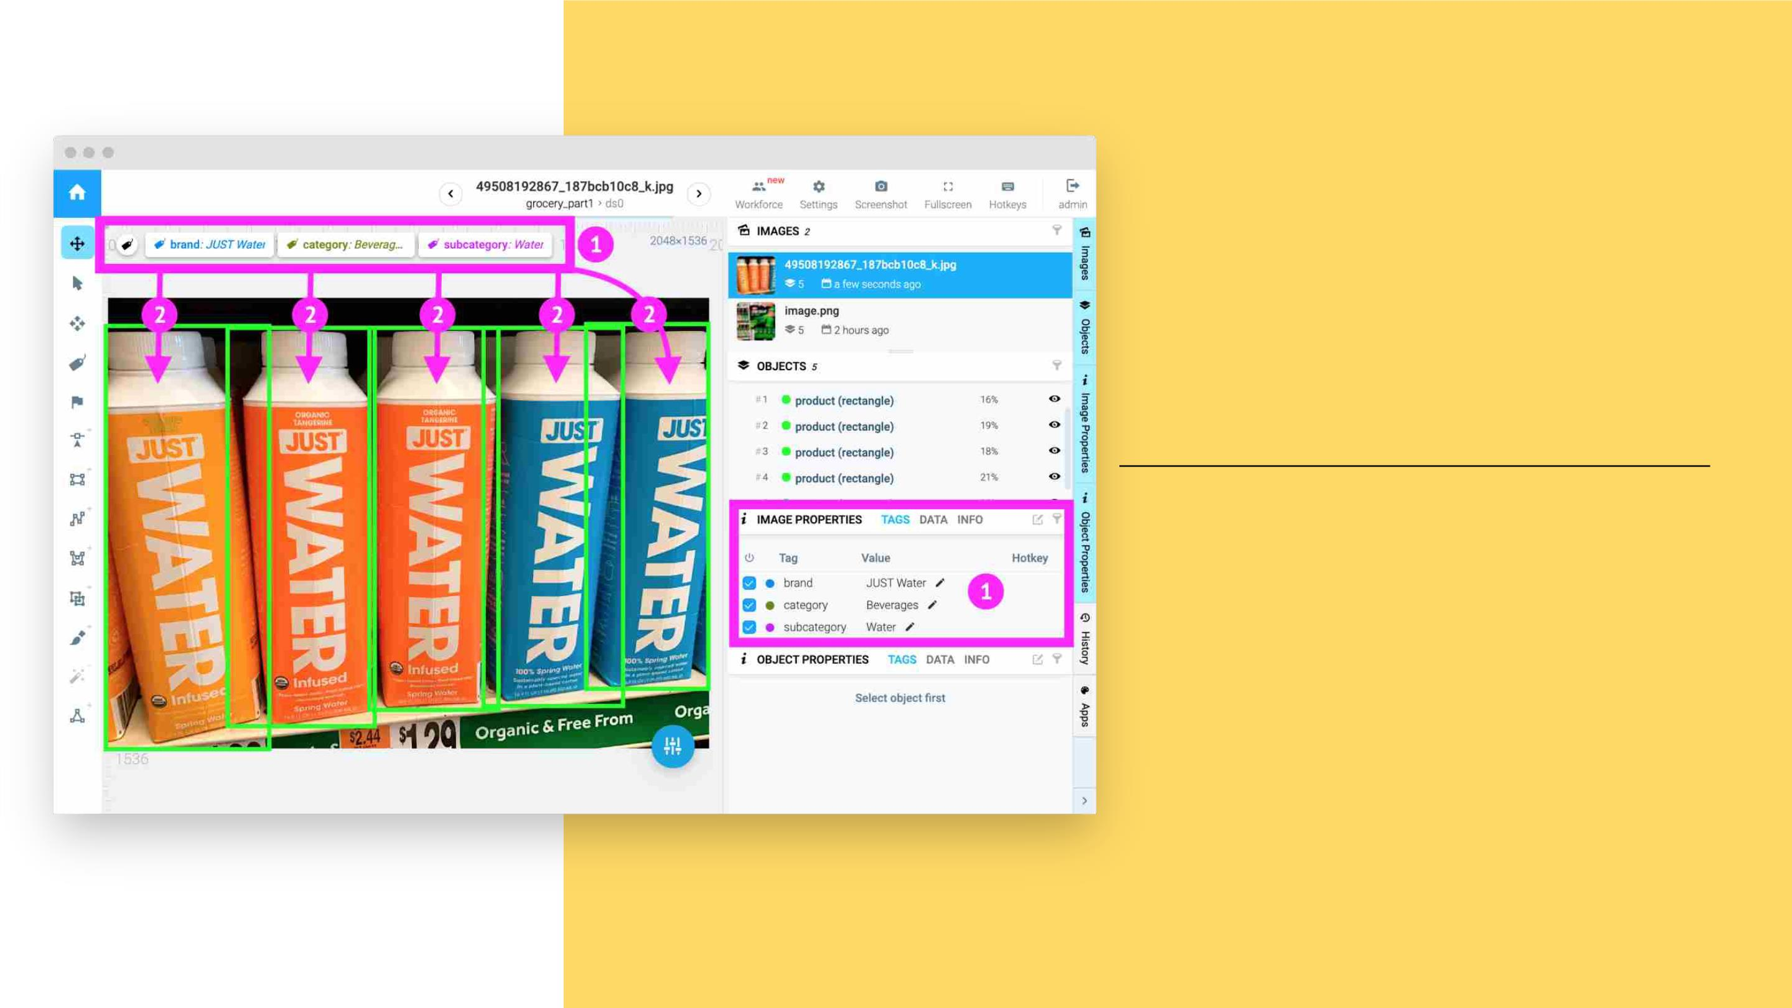
COPY
IMAGE TAGS
TO OBJECTS
Listꢀofꢀclassesꢀandꢀtags
canꢀbeꢀcustomizedꢀ

Slide 2
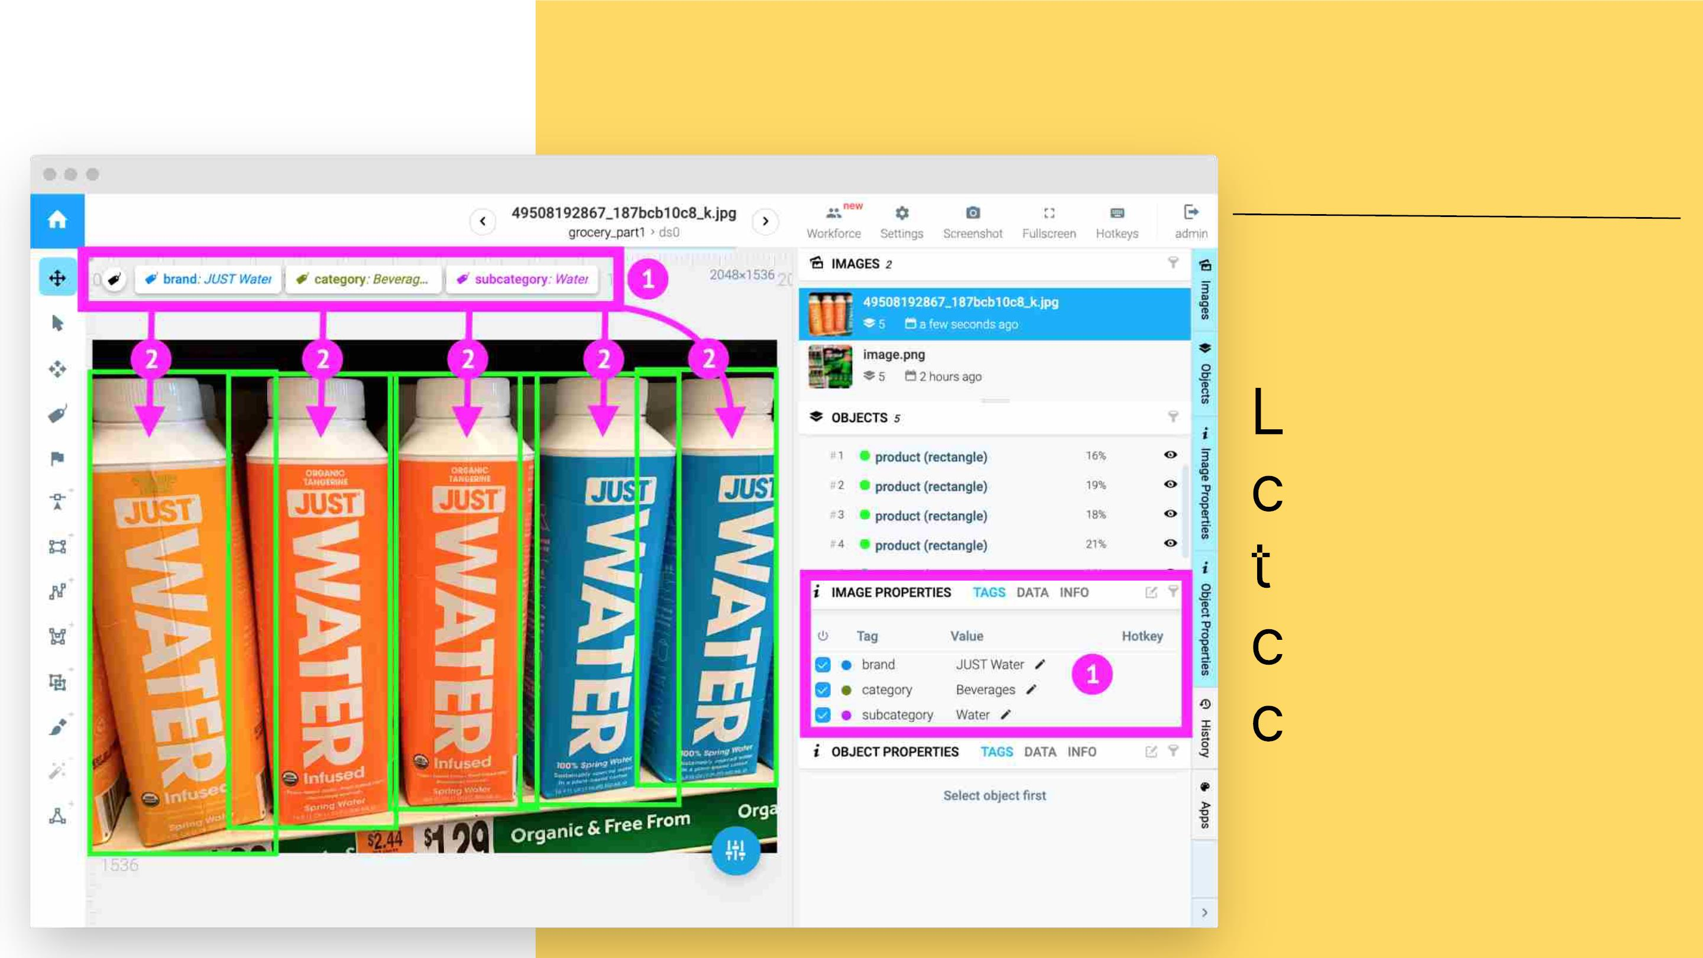
COPY IMAGE TAGS TO OBJECTS
istꢀofꢀ
lassesꢀandꢀ
ags
anꢀbeꢀ
ustomizedꢀ

Slide 3

CONTENTS OF THIS TEMPLATE
3
Here’sꢀwhatꢀyou’llꢀfindꢀinꢀthisꢀSlidesgoꢀtemplate:ꢀ
1. Aꢀslideꢀstructureꢀbasedꢀonꢀaꢀmulti-purposeꢀpresentation,ꢀwhichꢀyouꢀcanꢀeasilyꢀadaptꢀtoꢀ
yourꢀneeds.ꢀForꢀmoreꢀinfoꢀonꢀhowꢀtoꢀeditꢀtheꢀtemplate,ꢀpleaseꢀvisitꢀSlidesgoꢀSchoolꢀorꢀ
readꢀourꢀFAQs.
2. Anꢀassortmentꢀofꢀillustrationsꢀtoꢀuseꢀinꢀtheꢀpresentationꢀcanꢀbeꢀfoundꢀinꢀtheꢀalternativeꢀ
resourcesꢀslide.
3. Aꢀthanksꢀslide,ꢀwhichꢀyouꢀmustꢀkeepꢀsoꢀthatꢀproperꢀcreditsꢀforꢀourꢀdesignꢀareꢀgiven.
4. Aꢀresourcesꢀslide,ꢀwhereꢀyou’llꢀfindꢀlinksꢀtoꢀallꢀtheꢀelementsꢀusedꢀinꢀtheꢀtemplate.
5. Instructionsꢀforꢀuse.
6. Finalꢀslidesꢀwith:ꢀ
● Theꢀfontsꢀandꢀcolorsꢀusedꢀinꢀtheꢀtemplate.
● Moreꢀinfographicꢀresources,ꢀwhoseꢀsizeꢀandꢀcolorꢀcanꢀbeꢀedited.ꢀ
● Setsꢀofꢀcustomizableꢀiconsꢀofꢀtheꢀfollowingꢀthemes:ꢀgeneral,ꢀbusiness,ꢀavatar,ꢀ
creativeꢀprocess,ꢀeducation,ꢀhelpꢀ&ꢀsupport,ꢀmedical,ꢀnature,ꢀperformingꢀarts,ꢀSEOꢀ&ꢀ
marketing,ꢀandꢀteamwork.
Youꢀcanꢀdeleteꢀthisꢀslideꢀwhenꢀyou’reꢀdoneꢀeditingꢀtheꢀpresentation.

Slide 4

HELLO!
Evenꢀthoughꢀweꢀareꢀlivingꢀaꢀ
difficultꢀtime,ꢀourꢀfutureꢀisꢀ
stillꢀbright

Slide 5

TABLE OF CONTENTS
5
Introduction
Hereꢀyouꢀcouldꢀdescribeꢀ
theꢀtopicꢀofꢀtheꢀsection
01
02
03
Presentation
Hereꢀyouꢀcouldꢀdescribeꢀ
theꢀtopicꢀofꢀtheꢀsection
Conclusion
Hereꢀyouꢀcouldꢀdescribeꢀ
theꢀtopicꢀofꢀtheꢀsection

Slide 6
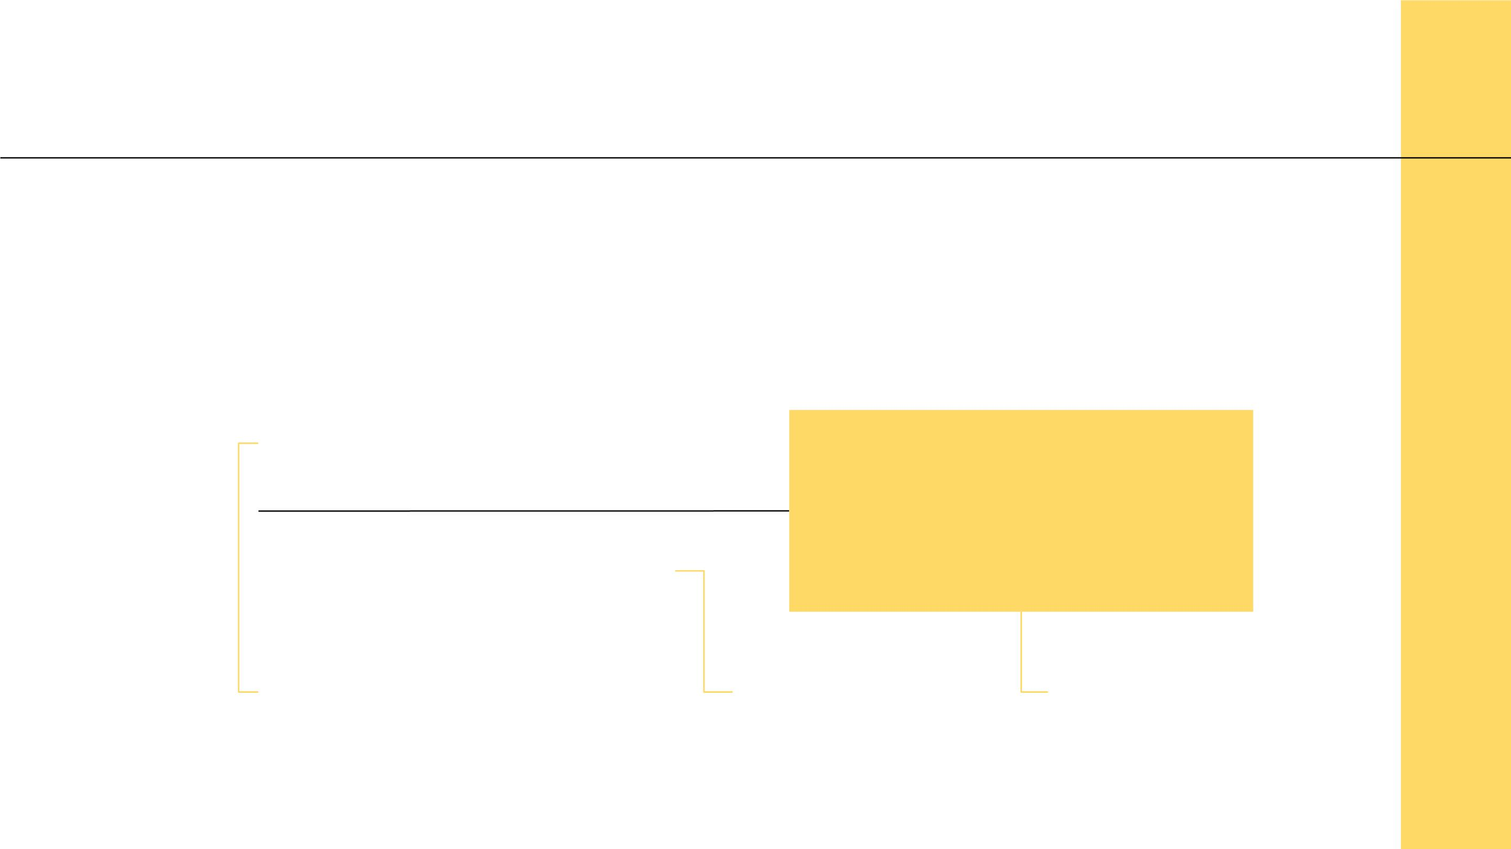
THE PANDEMIC
6
Let’sꢀrefreshꢀourꢀmemoryꢀwithꢀsomeꢀgeneralꢀdataꢀaboutꢀtheꢀvirus
1,854,197
427,913
114,293
Worldwideꢀcases
Deaths
Recovered

Slide 7
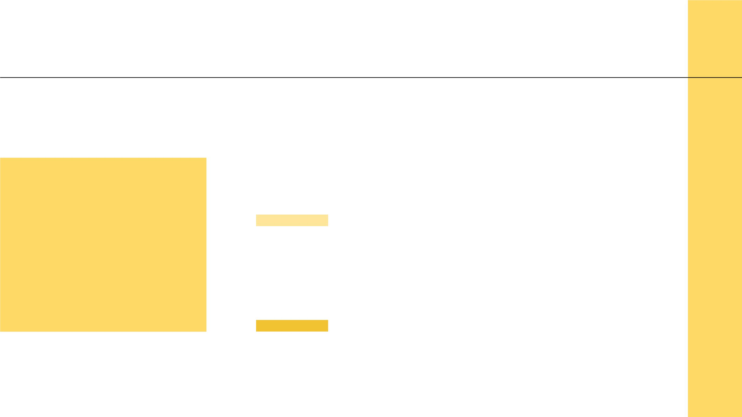
GENERAL VIEWS
7
Positive
01
02
Evolutionꢀofꢀhealthcare,ꢀnewꢀandꢀ
betterꢀhabits,ꢀreductionꢀofꢀinequality
Theseꢀtwoꢀtrendsꢀ
willꢀtellꢀusꢀwhat’sꢀ
toꢀcomeꢀandꢀwhatꢀ
toꢀexpect
Negative
Harsherꢀsurveillance,ꢀdivideꢀbetweenꢀ
countries,ꢀeconomicꢀrecession

Slide 8

CHANGES
IN SOCIETY
01
Howꢀsomeꢀglobalꢀtopicsꢀ
willꢀevolveꢀinꢀtimeꢀ

Slide 9
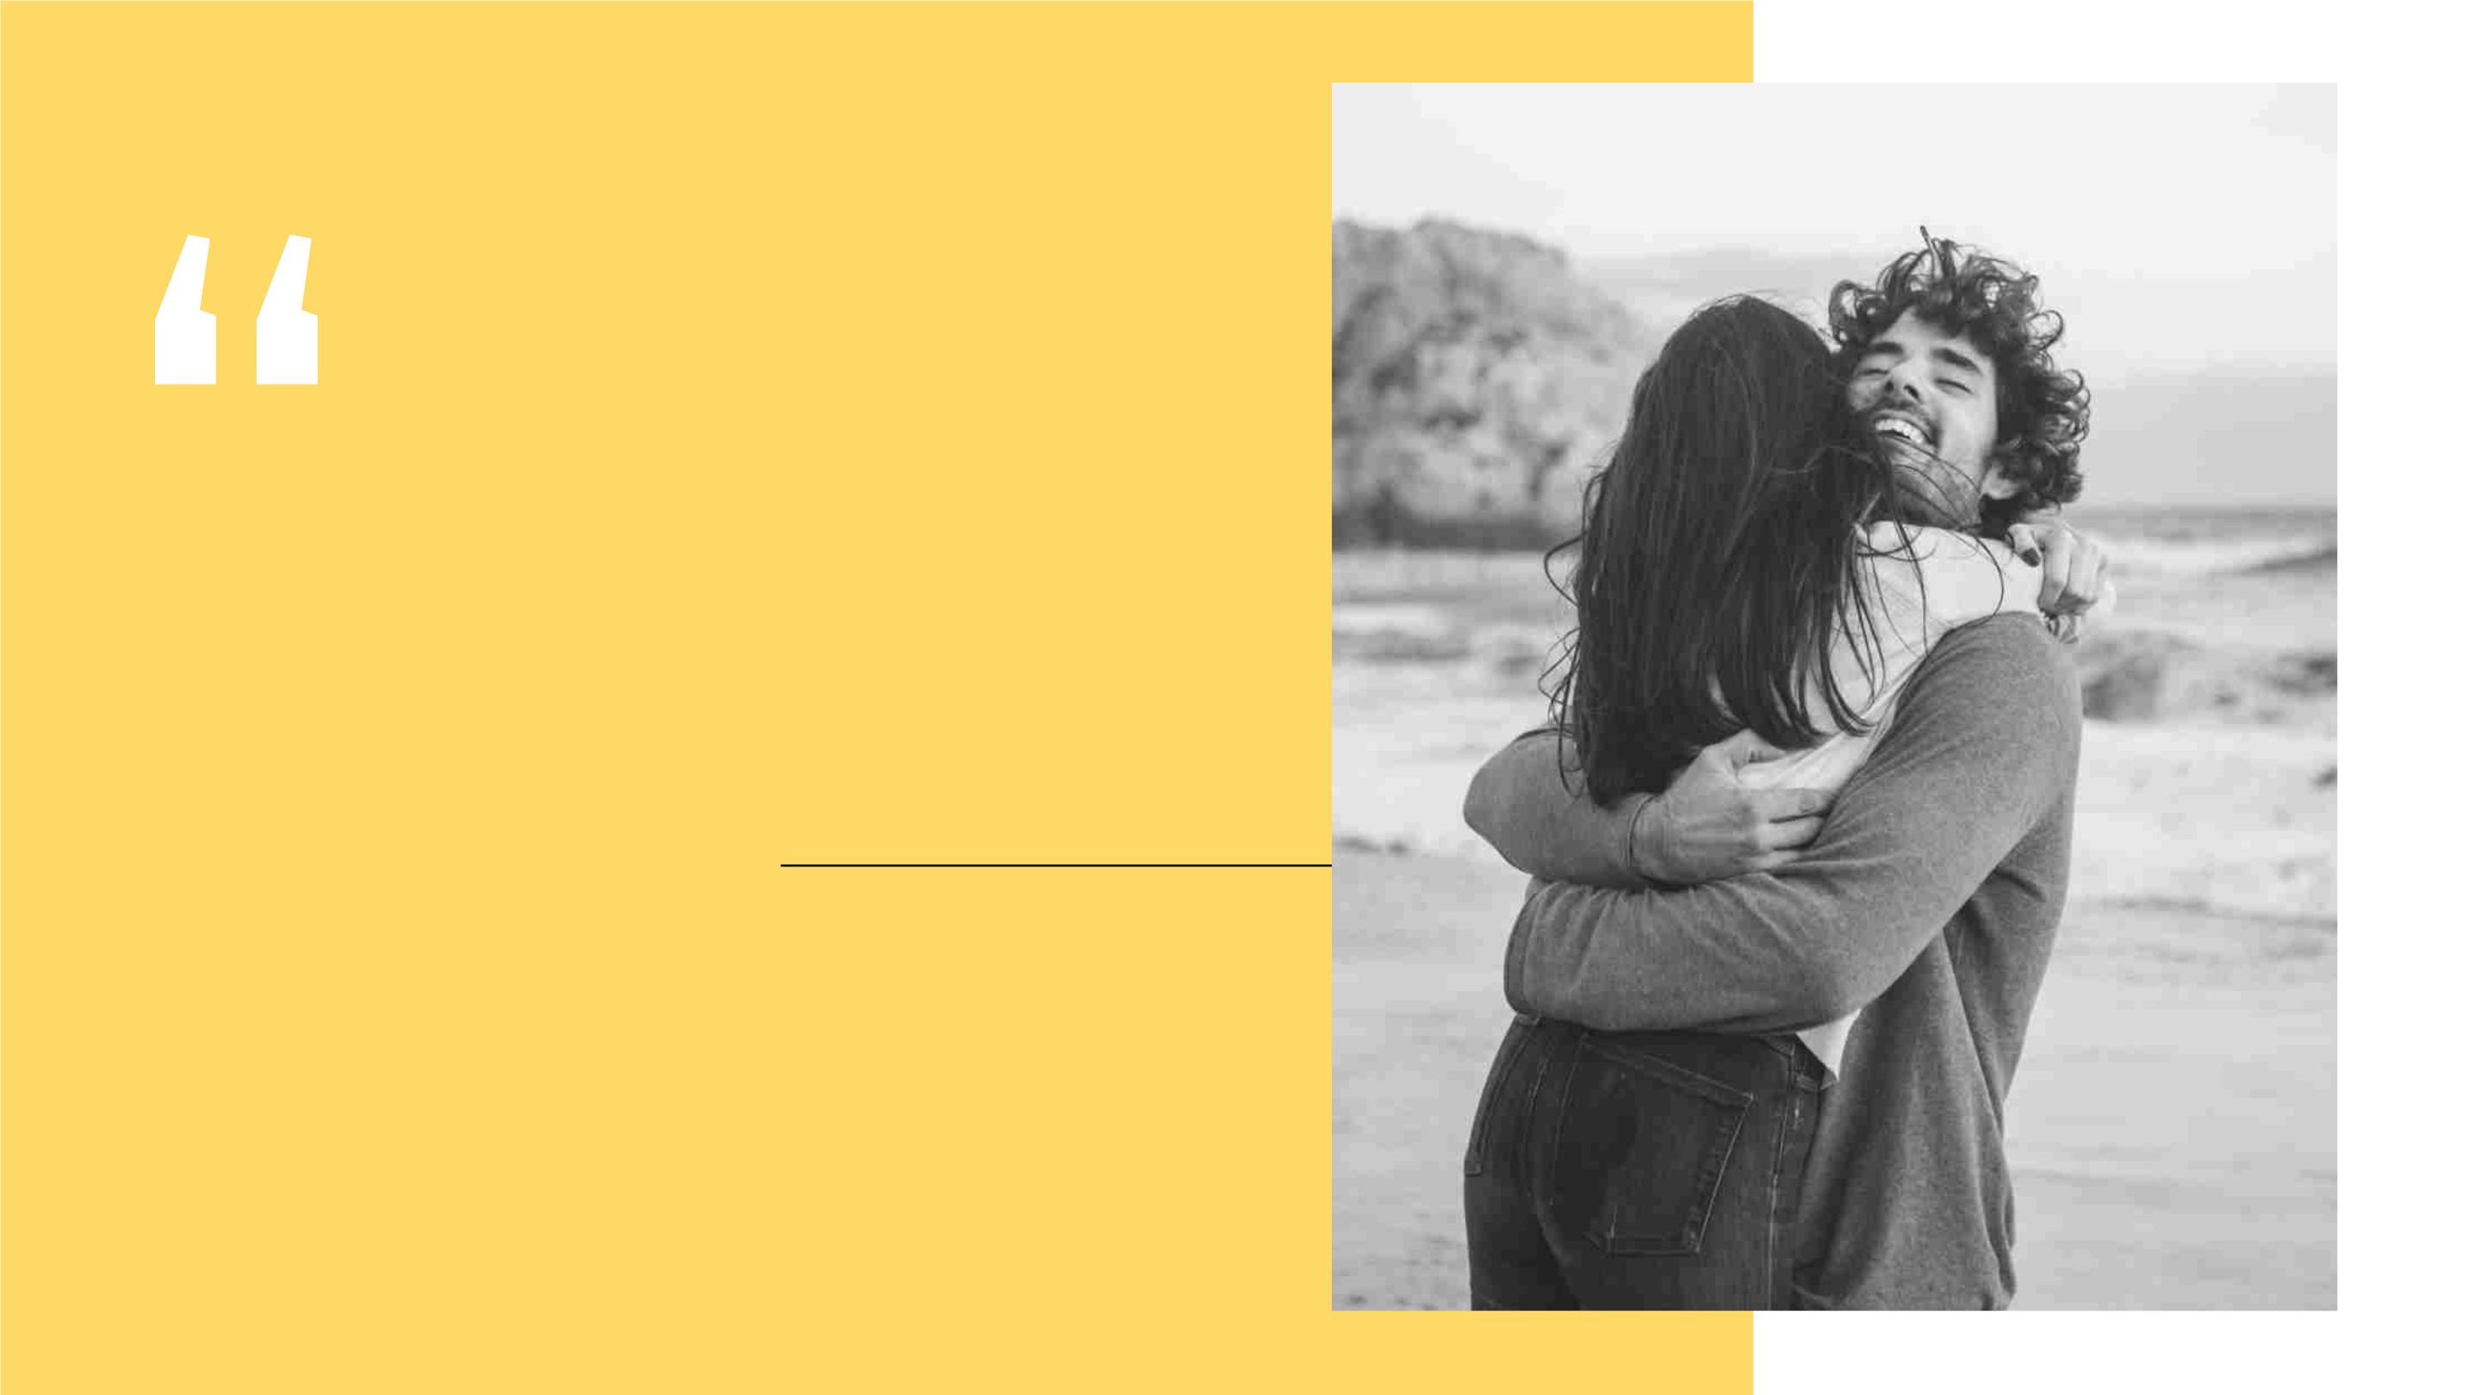
Optimismꢀisꢀtheꢀfaithꢀthatꢀ
leadsꢀtoꢀachievement.ꢀ
Nothingꢀcanꢀbeꢀdoneꢀ
withoutꢀhopeꢀandꢀ
confidence”
—Helen Keller,
American author and
political activist

Slide 10
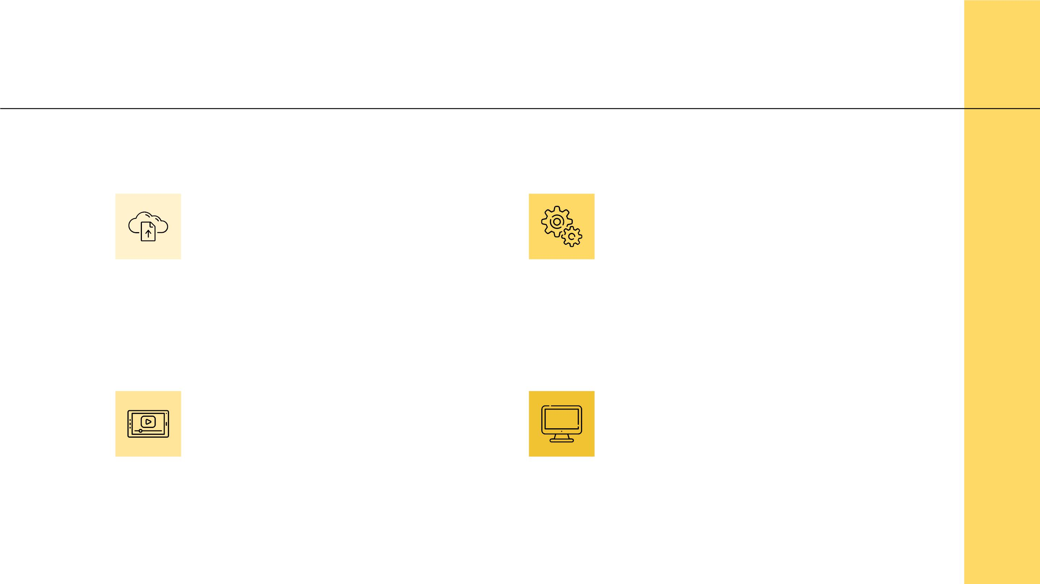
TECHNOLOGY
1
0
Cloud Capacity
Machine Learning
It’sꢀanꢀessentialꢀmeansꢀforꢀ
aꢀremote,ꢀhome-basedꢀ
workforce
Thisꢀisꢀaꢀpowerfulꢀtoolꢀthatꢀ
canꢀhelpꢀusꢀunderstandꢀtheꢀ
disease
Virtual Experience
Desktop Computers
VRꢀtechꢀallowsꢀpeopleꢀtoꢀ
travelꢀandꢀcommunicateꢀ
whileꢀatꢀhome
Theyꢀwillꢀbecomeꢀmoreꢀ
usefulꢀforꢀworkersꢀthanꢀ
smartphones

Slide 11

ECONOMY
11
01
02
03
Recession
Mindset
Trade
Weꢀmayꢀbeꢀfacingꢀaꢀ
We’llꢀstartꢀviewingꢀourꢀ
resourcesꢀasꢀthingsꢀweꢀ onꢀglobalꢀtradeꢀandꢀ
needꢀforꢀlivingꢀratherꢀthanꢀ moreꢀonꢀourꢀownꢀ
We’llꢀhaveꢀtoꢀrelyꢀlessꢀ
recessionꢀinꢀtheꢀ
futureꢀdueꢀtoꢀtheꢀlongꢀ
lockdown
itemsꢀtoꢀbeꢀconsumed
resources

Slide 12
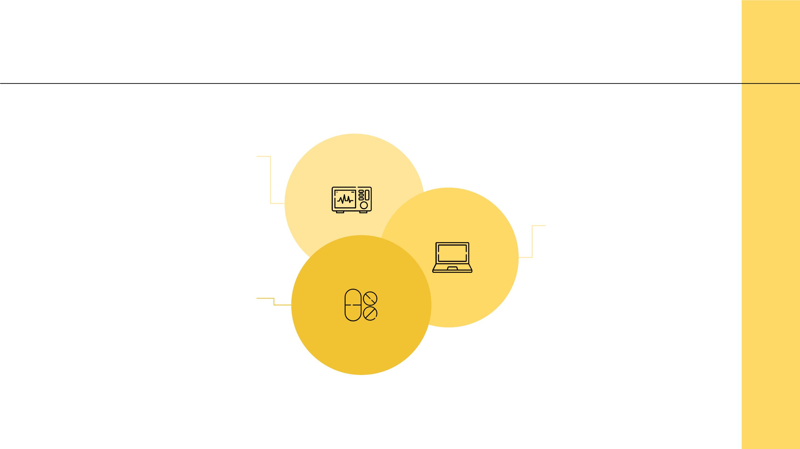
HEALTHCARE
12
Digital Tech
Usingꢀtechnologyꢀlikeꢀ
AI,ꢀchatbots,ꢀvoiceꢀ
searchꢀorꢀVR
Telemedicine
Remoteꢀmedicalꢀ
assistanceꢀviaꢀ
computerꢀꢀ
Home Testing
Usingꢀhomeꢀtestꢀkitsꢀ
andꢀconsultingꢀdoctorsꢀ
withoutꢀleavingꢀhome

Slide 13

13
REDUCED
INEQUALITY
Thereꢀisꢀanꢀeffortꢀtoꢀhelpꢀworkersꢀinꢀ
theꢀinformalꢀsector.ꢀIfꢀtheseꢀpoliciesꢀ
persistꢀafterꢀtheꢀoutbreak,ꢀthisꢀwillꢀ
helpꢀreduceꢀinequality

Slide 14
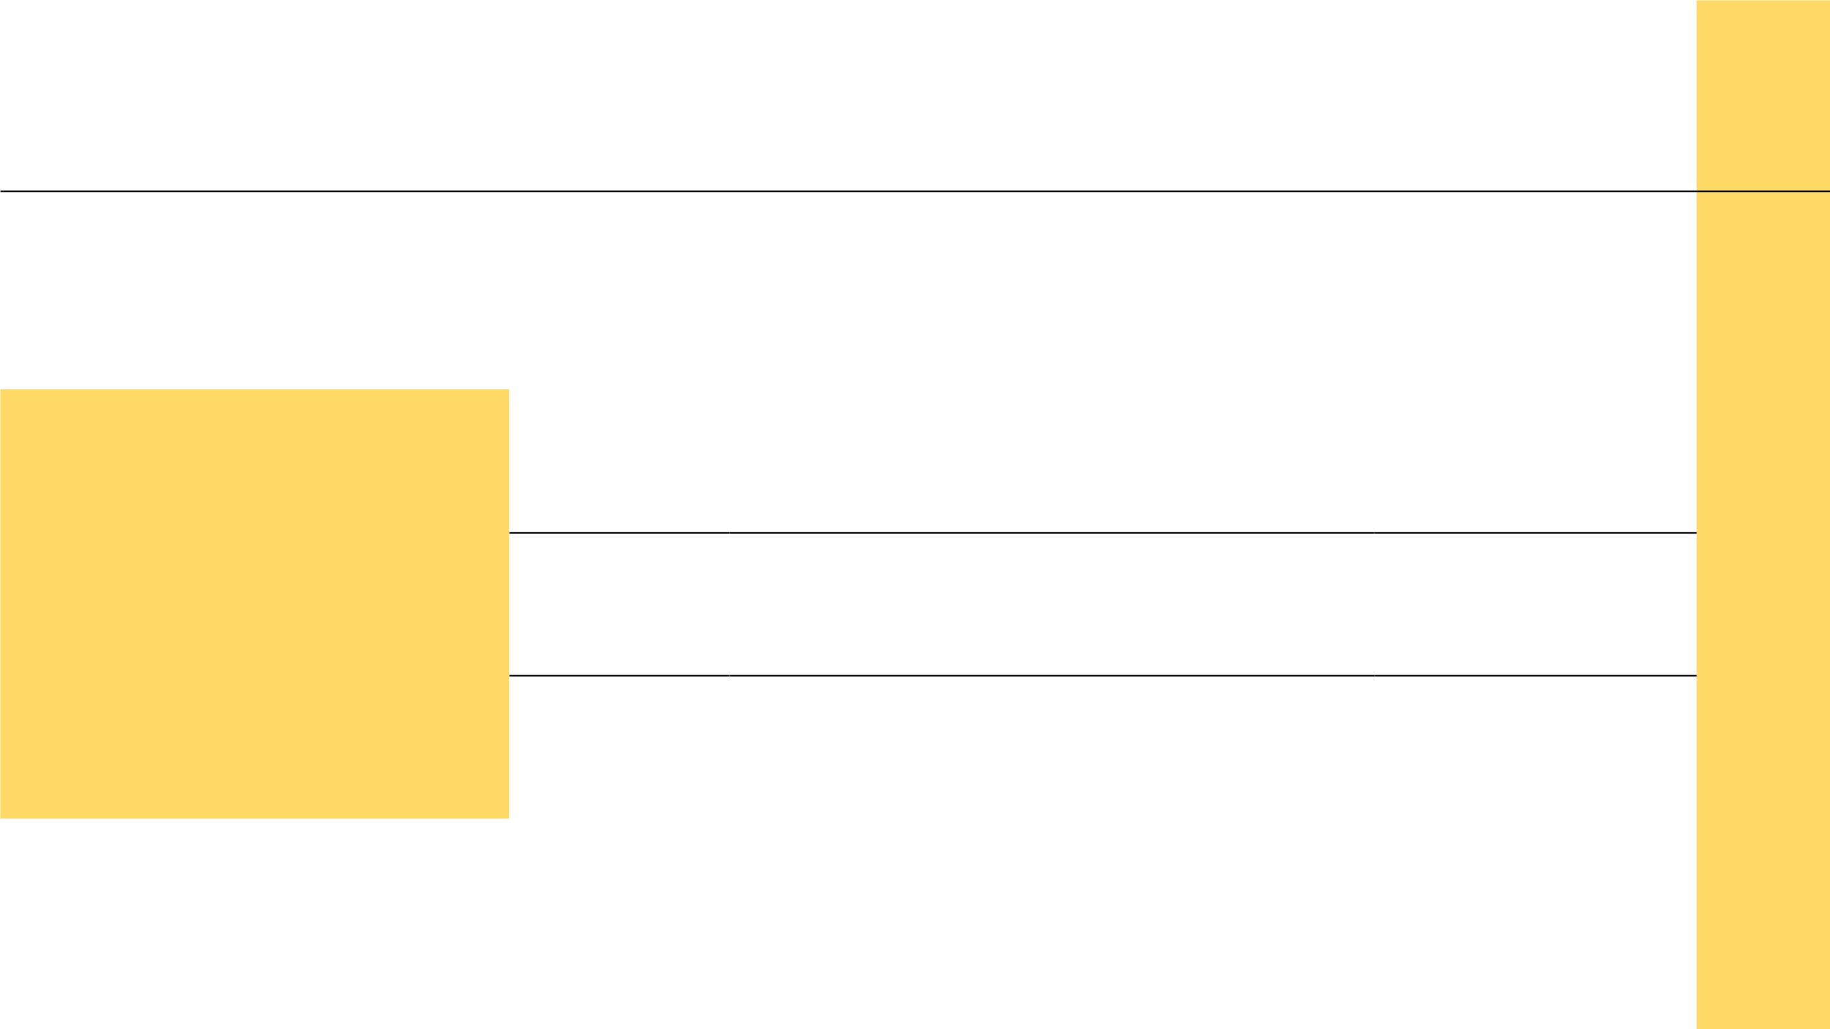
TOURISM
14
ARRIVALS
EXPORTS
RECEIPTS
(MILLIONS) (USD BILLION) (REAL CHANGE)
2018
2019
2020
1,408
1,460
1,020
1,463
1,507
1,060
5.0%
3.0%
-30%
Howꢀtheꢀpandemicꢀ
willꢀaffectꢀtheꢀ
tourism

Slide 15

-440,000,000
Lossꢀinꢀtheꢀamountꢀofꢀ
internationalꢀtourismꢀ
arrivals

Slide 16
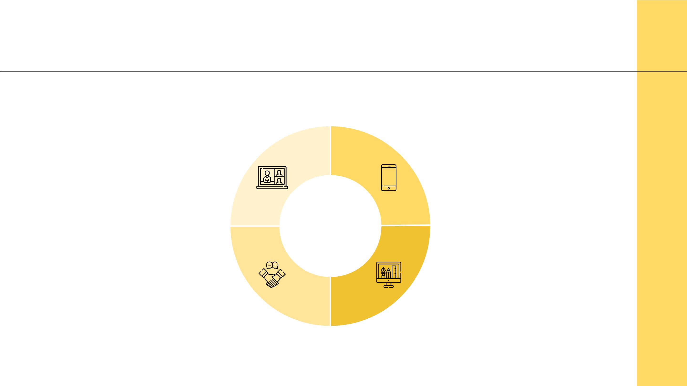
EDUCATION
16
Online Learning
5G
Doneꢀviaꢀinteractiveꢀ
appꢀorꢀliveꢀonlineꢀ
classes
Itꢀwillꢀbecomeꢀaꢀmoreꢀ
prevalentꢀsystemꢀinꢀ
someꢀcountries
Coalitions
Digital Division
Companiesꢀwillꢀuniteꢀ
toꢀhelpꢀwithꢀaꢀbetterꢀ
education
Lessꢀdigital-savvyꢀ
familiesꢀcouldꢀbeꢀleftꢀ
behind

Slide 17

BLACK SWAN THEORY
17
● Thisꢀisꢀaꢀcataclysmꢀthatꢀhasꢀcausedꢀgreatꢀ
economicꢀhardshipꢀandꢀthatꢀcouldꢀnotꢀhaveꢀ
beenꢀforeseen
● Policymakersꢀcanꢀthereforeꢀuseꢀtheꢀdataꢀfromꢀ
thisꢀcrisisꢀtoꢀplanꢀforꢀfutureꢀcrises
● Companiesꢀshouldꢀlearnꢀfromꢀwhatꢀhasꢀworkedꢀ
bestꢀandꢀmakeꢀitꢀpartꢀofꢀtheirꢀvaluesꢀ
permanently

Slide 18

CHANGES IN
OURSELVES
02
Ourꢀownꢀhabitsꢀandꢀvaluesꢀ
willꢀchangeꢀtoo

Slide 19
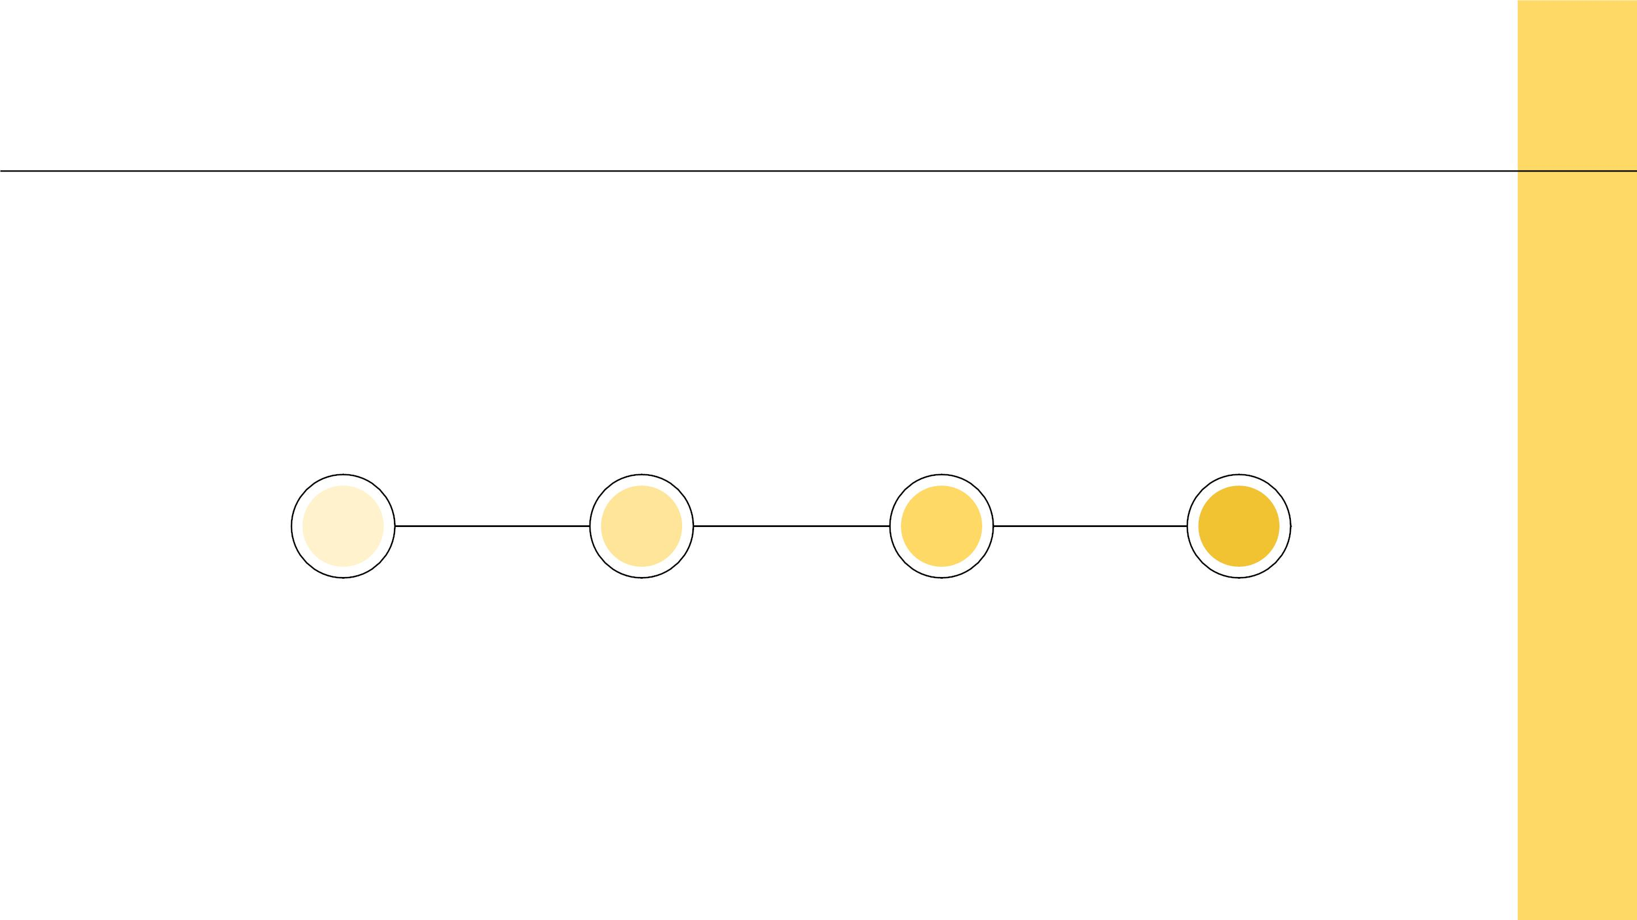
LIFE AND VALUES
19
Familiesꢀwillꢀnowꢀbeꢀ
ableꢀtoꢀspendꢀmoreꢀ
timeꢀtogether
Moreꢀcreativityꢀandꢀ
freedomꢀtranslatesꢀ
intoꢀinnovation
Family Time
New Habits
01
02
03
04
Slow Life
Creativity
Withꢀtheꢀnewꢀroutineꢀ
comesꢀaꢀmoreꢀrelaxedꢀ
wayꢀofꢀliving
Moreꢀtimeꢀtoꢀplayꢀ
meansꢀanꢀincreaseꢀinꢀ
creativity

Slide 20
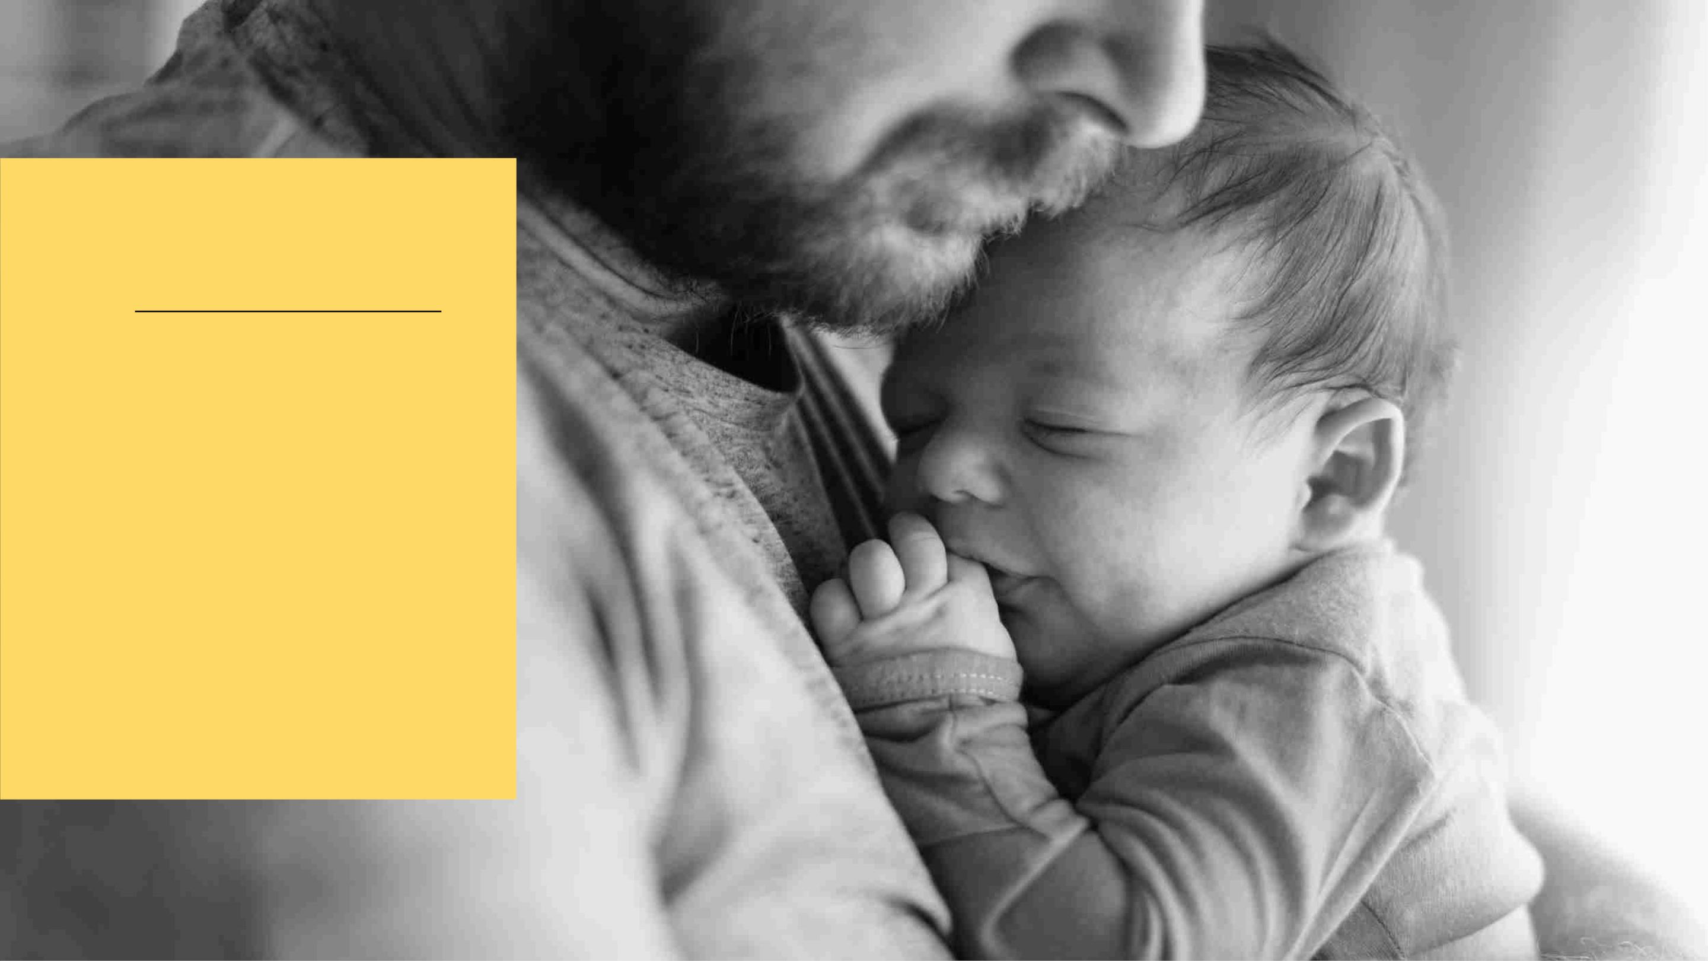
Home
Sweet
Home

Slide 21

SOCIAL LIFE
21
Through Tech
In-person
● Videoꢀcalling
● Texting
● Onlineꢀgames
HOW WILL WE
CONNECT?
● Oneꢀtoꢀone
● Smallꢀgatherings
● Keepingꢀdistance

Slide 22

EVERYDAY HABITS
22
● Thereꢀwillꢀbeꢀmoreꢀhandꢀsanitizerꢀ
availableꢀinꢀpublicꢀspaces
● Moreꢀcompaniesꢀwillꢀallowꢀemployeesꢀ
toꢀworkꢀremotely
● Peopleꢀwillꢀtakeꢀtheirꢀpersonalꢀspaceꢀ
moreꢀseriously
● Weꢀmayꢀhaveꢀaꢀbetterꢀunderstandingꢀ
ofꢀpublic-healthꢀethics
● Schoolsꢀandꢀuniversitiesꢀwillꢀbeꢀmoreꢀ
preparedꢀforꢀdistanceꢀlearning

Slide 23

TRAVEL
23
Outdoor
Family Trips
Spiritual
Peopleꢀwillꢀwantꢀtoꢀgoꢀ
toꢀnationalꢀparksꢀandꢀ
campgrounds
Bigꢀtravelsꢀtoꢀkid-
friendlyꢀplacesꢀforꢀ
families
Meaningfulꢀandꢀ
spiritualꢀtravelsꢀwillꢀbeꢀ
preferredꢀ
Roadtrip
Value
Long Weekend
Roadꢀtravelingꢀwillꢀbeꢀ
preferredꢀoverꢀflyingꢀorꢀ
cruising
Companiesꢀwillꢀofferꢀ
valueꢀpacksꢀinsteadꢀofꢀ
cheapꢀoffers
Peopleꢀwillꢀgoꢀoutꢀonꢀ
vacationꢀforꢀshorterꢀ
periodsꢀofꢀtime

Slide 24
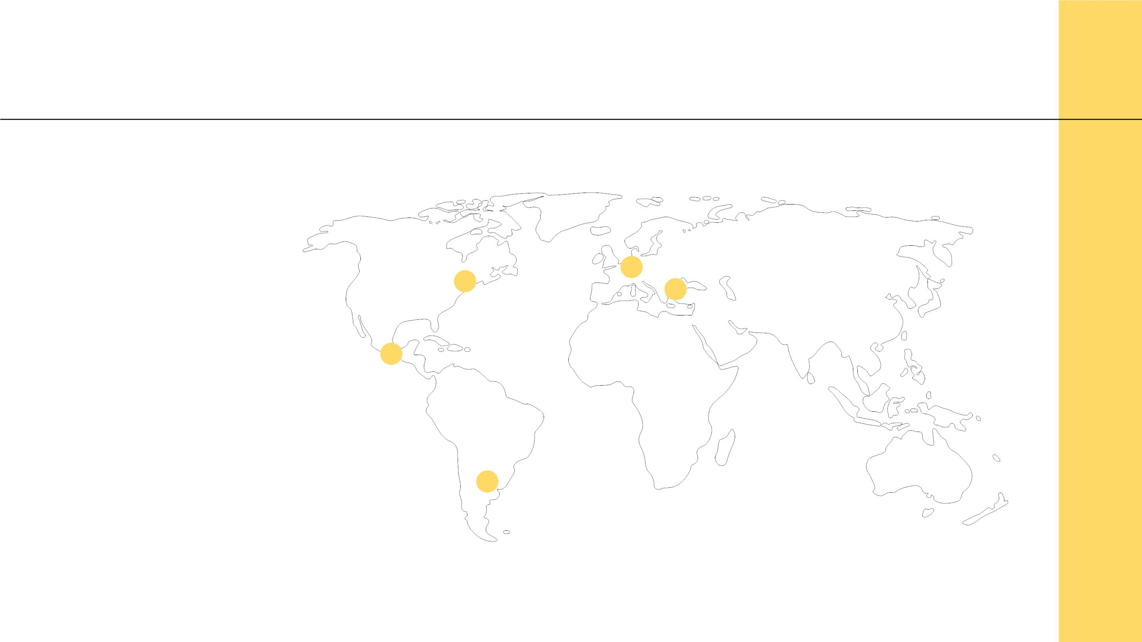
FUTURE TRAVEL LOCATIONS
24
Spotsꢀwhereꢀtheꢀ
virusꢀhasꢀhadꢀlessꢀ
presenceꢀwillꢀbeꢀtheꢀ
mostꢀvisitedꢀplaces

Slide 25
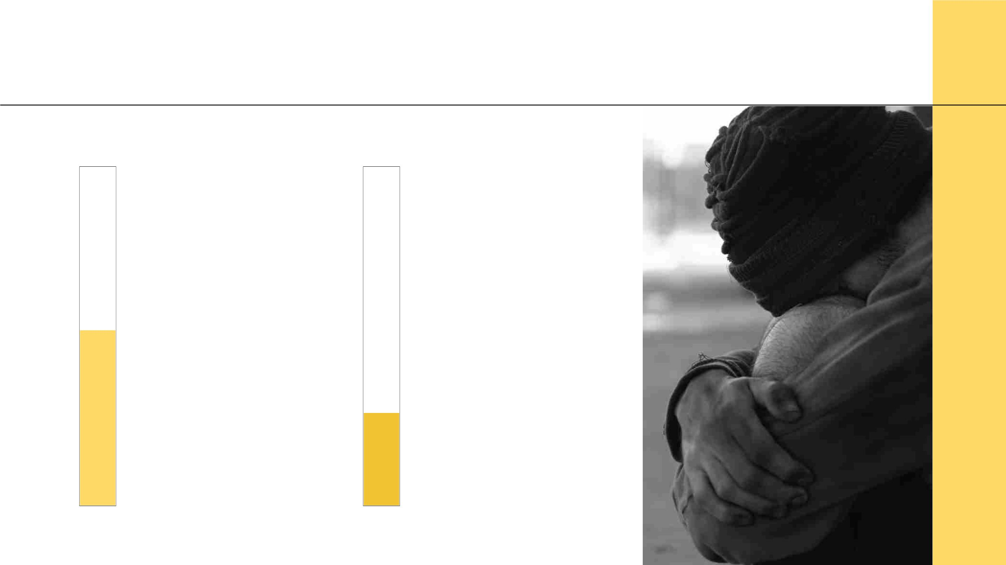
MENTAL HEALTH
45%
25
19%
ofꢀadultsꢀwillꢀ
haveꢀtheirꢀmentalꢀ
healthꢀaffected
ofꢀadults’ꢀmentalꢀ
healthꢀwillꢀsufferꢀ
aꢀmajorꢀimpact

Slide 26

We’ll Get
Through This

Slide 27
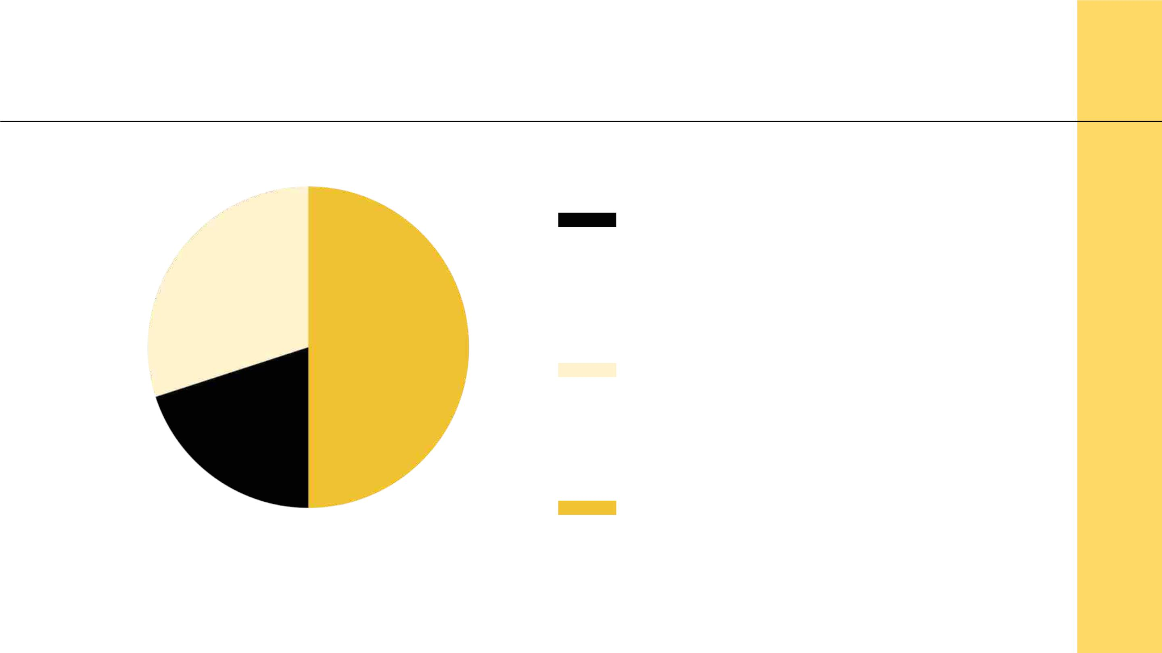
NEW TRENDS
27
20% Sensory Stimulus
PlacesꢀlikeꢀtheꢀHapticsꢀ
Museumꢀhelpꢀpeopleꢀgetꢀusedꢀ
toꢀtouchꢀagain
30% Shop Streaming
Mightꢀbeꢀtheꢀnextꢀdirectionꢀforꢀ
onlineꢀshoppingꢀandꢀsocialꢀ
connections
50% Assisted Development
Manyꢀwillꢀbeꢀforcedꢀtoꢀlearnꢀ
neglectedꢀlifeꢀskillsꢀwithꢀtheꢀ
helpꢀofꢀapps
Toꢀmodifyꢀthisꢀgraph,ꢀclickꢀonꢀit,ꢀfollowꢀtheꢀ
link,ꢀchangeꢀtheꢀdataꢀandꢀreplaceꢀthisꢀoneꢀ

Slide 28
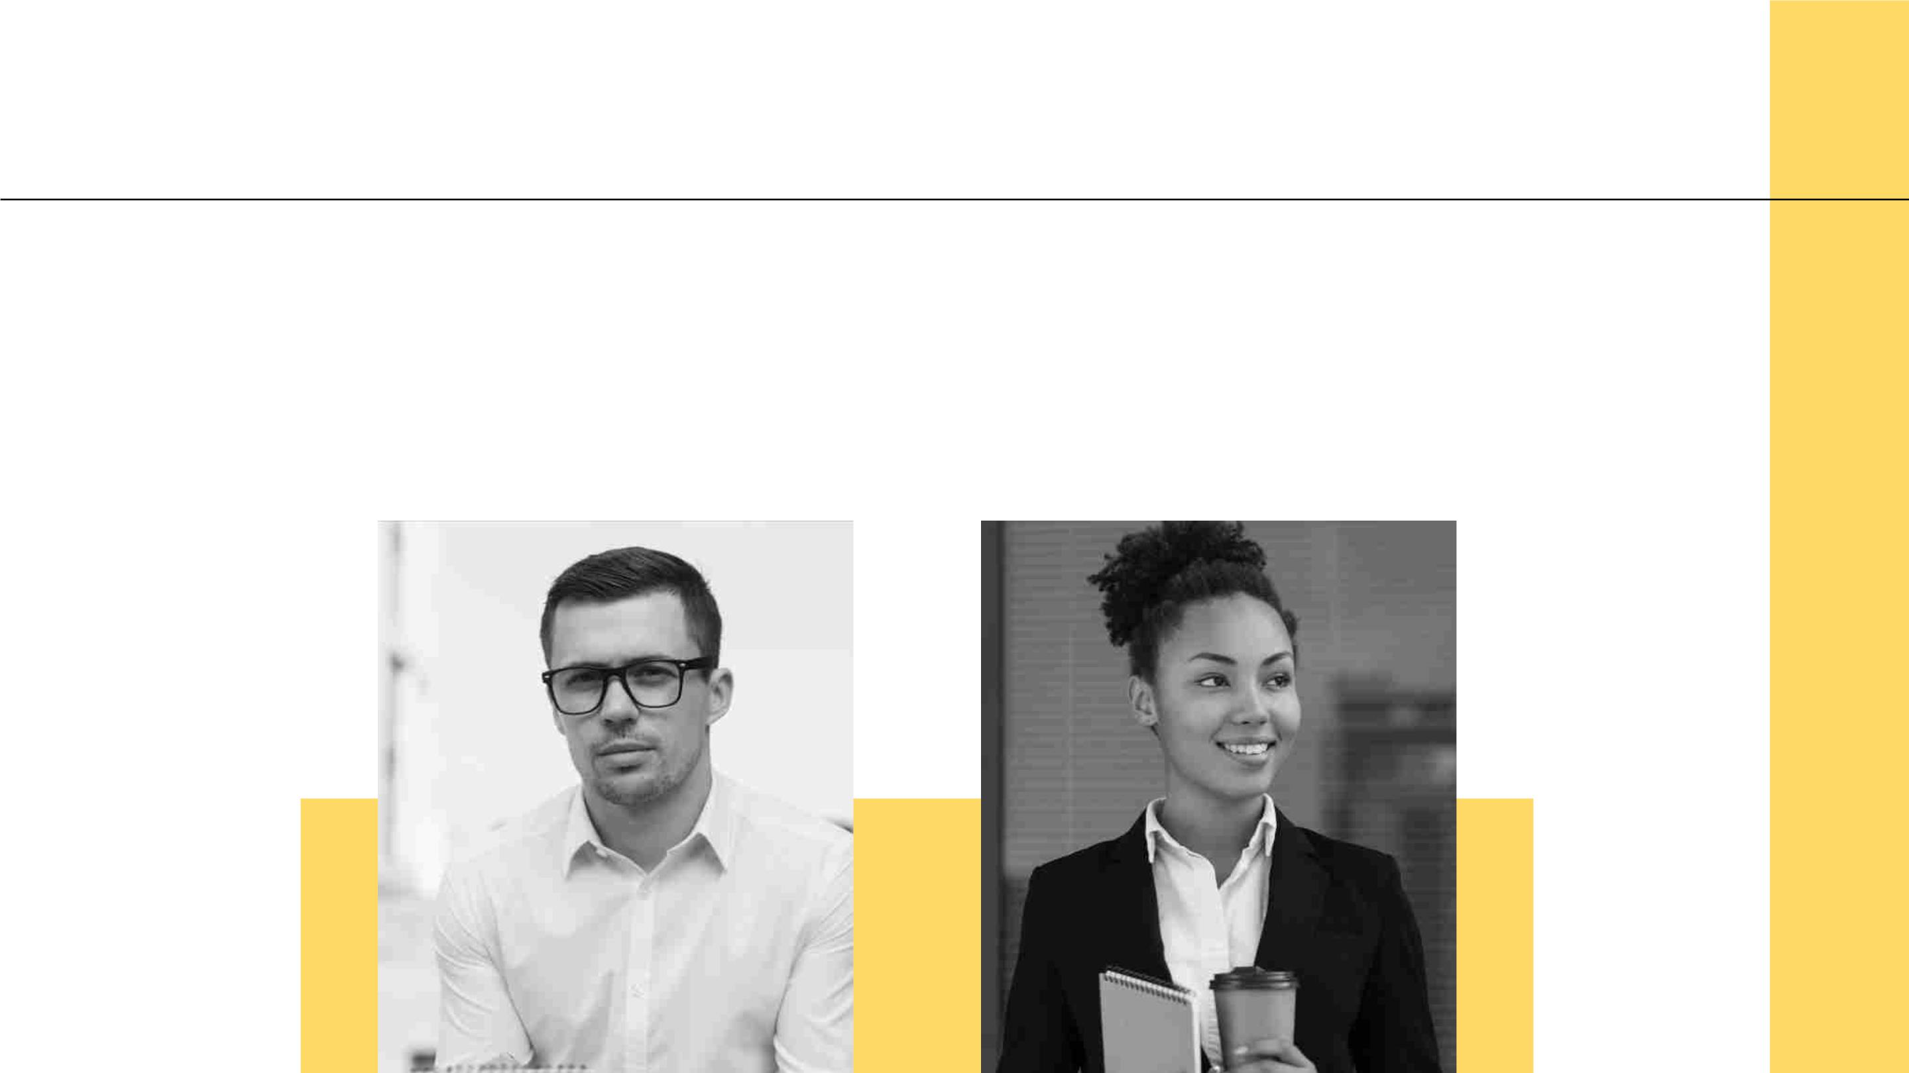
OUR TEAM
28
01
Richard Roe
DataꢀAnalyst
Eleanor Adams
02
Scientist

Slide 29
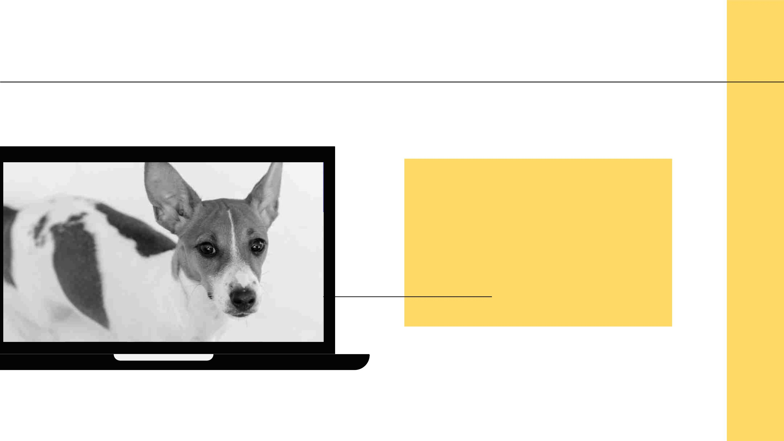
PETS
29
Manyꢀpeopleꢀhaveꢀadoptedꢀ
petsꢀasꢀaꢀsolutionꢀtoꢀ
loneliness,ꢀsoꢀabandonmentꢀ
ratesꢀcouldꢀdecrease

Slide 30
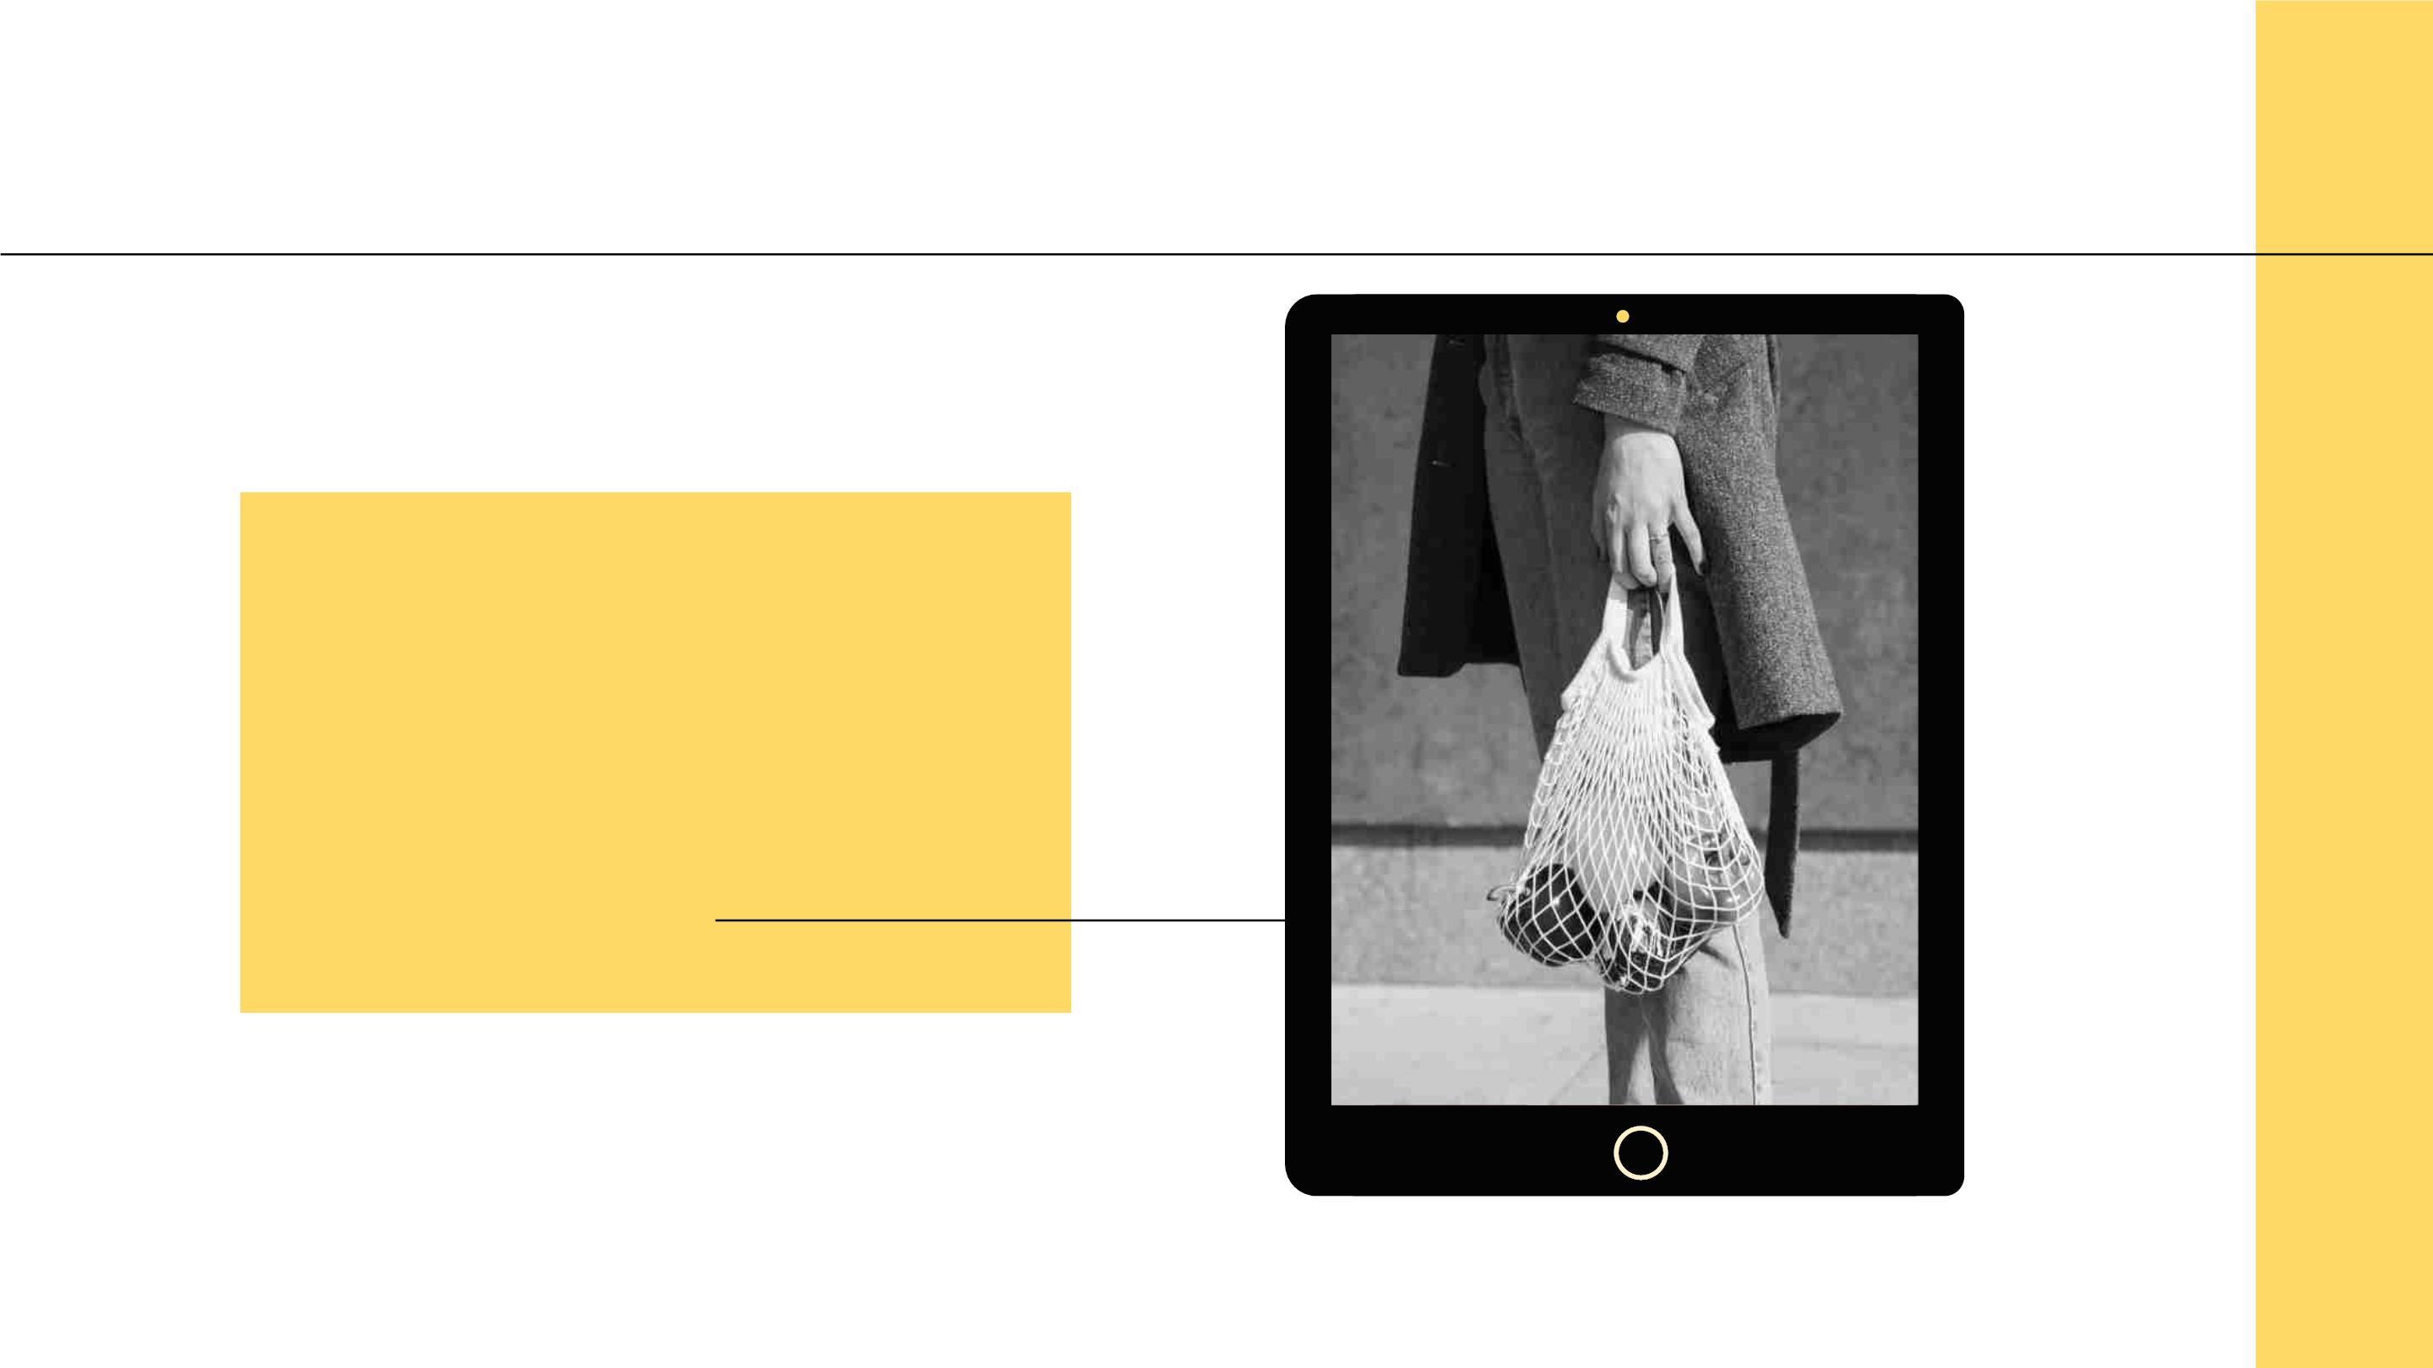
GROCERY SHOPPING
30
Weꢀwillꢀbeꢀmoreꢀ
sensibleꢀaboutꢀwhatꢀweꢀ
buy,ꢀpurchasingꢀbasicꢀ
goodsꢀfirst

Slide 31
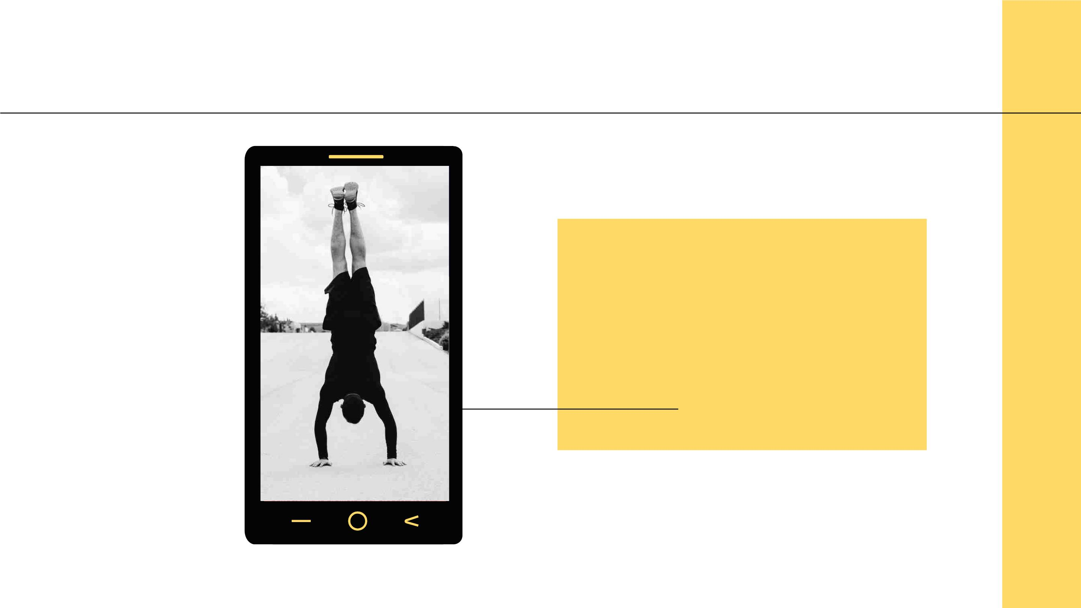
EXERCISE
31
Itꢀisꢀlikelyꢀthatꢀmostꢀpeopleꢀ
willꢀstartꢀdoingꢀoutdoorꢀ
exerciseꢀagain,ꢀratherꢀthanꢀ
justꢀgoingꢀtoꢀtheꢀgym

Slide 32

THANKS!
Doꢀyouꢀhaveꢀanyꢀquestions?
youremail@freepik.comꢀ
+91ꢀꢀ620ꢀ421ꢀ838ꢀ
yourcompany.com
CREDITS:ꢀThisꢀpresentationꢀtemplateꢀwasꢀcreatedꢀ
byꢀSlidesgo,ꢀincludingꢀiconsꢀbyꢀFlaticon,ꢀandꢀ
infographicsꢀ&ꢀimagesꢀbyꢀFreepik
Pleaseꢀkeepꢀthisꢀslideꢀforꢀattribution

Slide 33

ALTERNATIVE RESOURCES
33
Here’sꢀanꢀassortmentꢀofꢀalternativeꢀ
picturesꢀwithinꢀtheꢀsameꢀstyleꢀofꢀthisꢀ
template.ꢀ
● Lowꢀangleꢀnurseꢀworking
● Bestꢀfemaleꢀfriendsꢀsittingꢀonꢀaꢀhill
● Close-upꢀfatherꢀkissingꢀbabyꢀ
dressedꢀinꢀyellow
● Unrecognizableꢀmanꢀhavingꢀvideoꢀ ● Lowꢀangleꢀnurseꢀworking
conversation
● Beggarꢀmanꢀwaitingꢀonꢀtheꢀcityꢀ
streets
● Fatherꢀandꢀsonꢀhuggingꢀonꢀskyꢀ
background
● Seniorꢀmanꢀtalkingꢀtoꢀhisꢀchildrenꢀ
throughꢀaꢀtablet
● Close-upꢀorganicꢀbagꢀwithꢀfreshꢀ
vegetables
● Close-upꢀofꢀtwoꢀpeopleꢀstretchingꢀ
outdoors
● Youngꢀmanꢀworkingꢀinꢀofficeꢀwithꢀ
colleague

Slide 34
RESOURCES
34
Didꢀyouꢀlikeꢀtheꢀresourcesꢀonꢀthisꢀ
template?ꢀGetꢀthemꢀforꢀfreeꢀatꢀourꢀ
otherꢀwebsites.
● Manꢀcrossingꢀroadꢀonꢀbusyꢀstreet
● Close-upꢀyoungꢀnurseꢀwearingꢀmask
● Crosswalkꢀinꢀsunnyꢀweather
● Coupleꢀhuggingꢀwithꢀlotsꢀofꢀenergy
● Blurredꢀpeopleꢀcrossingꢀtheꢀstreet
● Close-upꢀfatherꢀhuggingꢀhisꢀbabyꢀ
● Manꢀworkingꢀatꢀdesk
● Professionalꢀmanꢀwithꢀglassesꢀ
mediumꢀshot
● Professionalꢀworkingꢀwomanꢀsmiling
● Highꢀangleꢀofꢀcuteꢀdog
● Womanꢀcarryingꢀorganicꢀvegetables
● Manꢀdoingꢀhandstandꢀexerciseꢀonꢀ
street
● Homelessꢀmanꢀsittingꢀonꢀtheꢀstreets
● Womanꢀtouchingꢀtreeꢀwithꢀhand
● Fullꢀshotꢀwomanꢀwalkingꢀwithꢀdog

Slide 35

Instructions for use
In order to use this template, you must credit Slidesgo by keeping the Thanks slide.
You are allowed to:
- Modify this template.
- Use it for both personal and commercial projects.
You are not allowed to:
- Sublicense, sell or rent any of Slidesgo Content (or a modified version of Slidesgo Content).
- Distribute Slidesgo Content unless it has been expressly authorized by Slidesgo.
- Include Slidesgo Content in an online or offline database or file.
- Offer Slidesgo templates (or modified versions of Slidesgo templates) for download.
- Acquire the copyright of Slidesgo Content.
For more information about editing slides, please read our FAQs or visit Slidesgo School:
https://slidesgo.com/faqs and https://slidesgo.com/slidesgo-school

Slide 36

Fonts & colors used
This presentation has been made using the following fonts:
Abel
(https://fonts.google.com/specimen/Abel)
Inter
(https://fonts.google.com/specimen/Inter)
#040404
#ffd966

Slide 37

Use our editable graphic resources...
You can easily resize these resources without losing quality. Tochange the color, just ungroup the resource
and click on the object you want to change. Then, click on the paint bucket and select the color you want.
Group the resource again when you’re done.

Slide 38
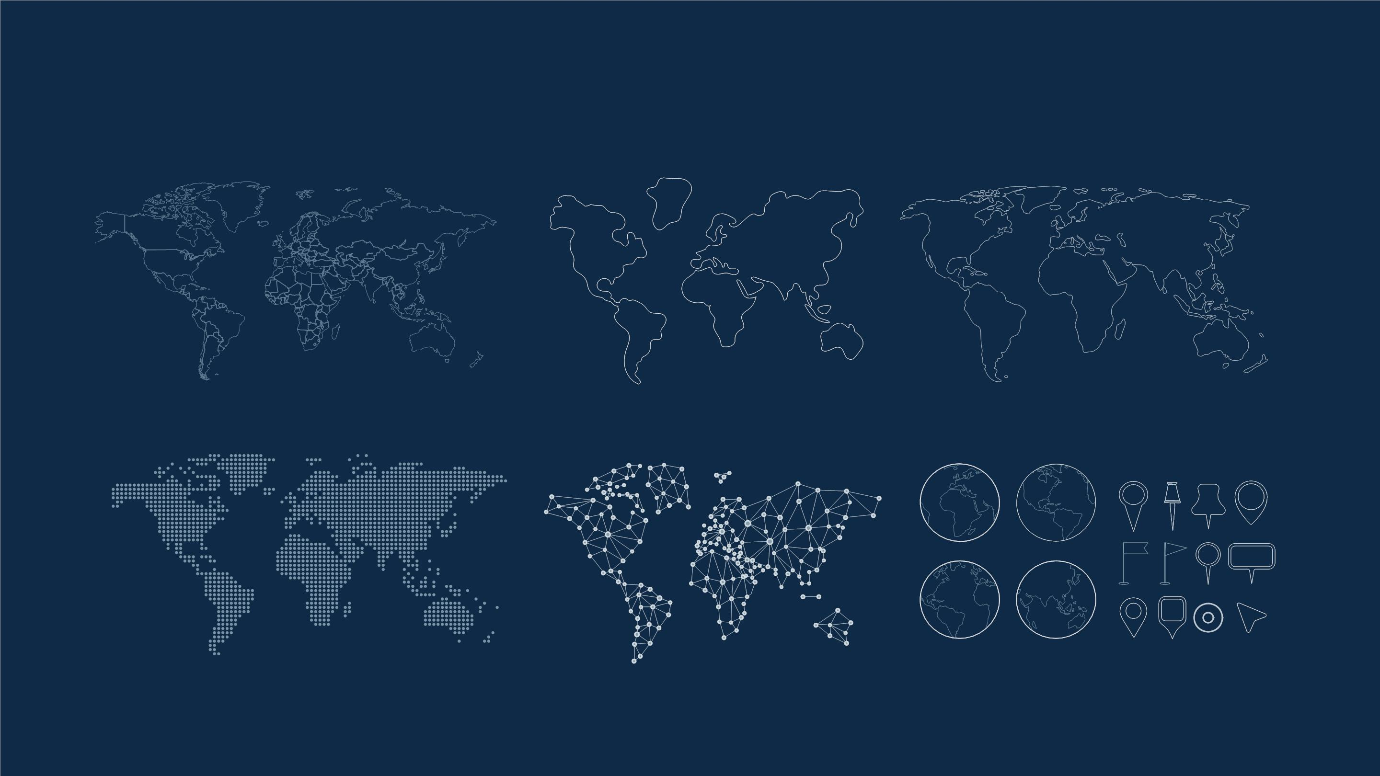

Slide 39
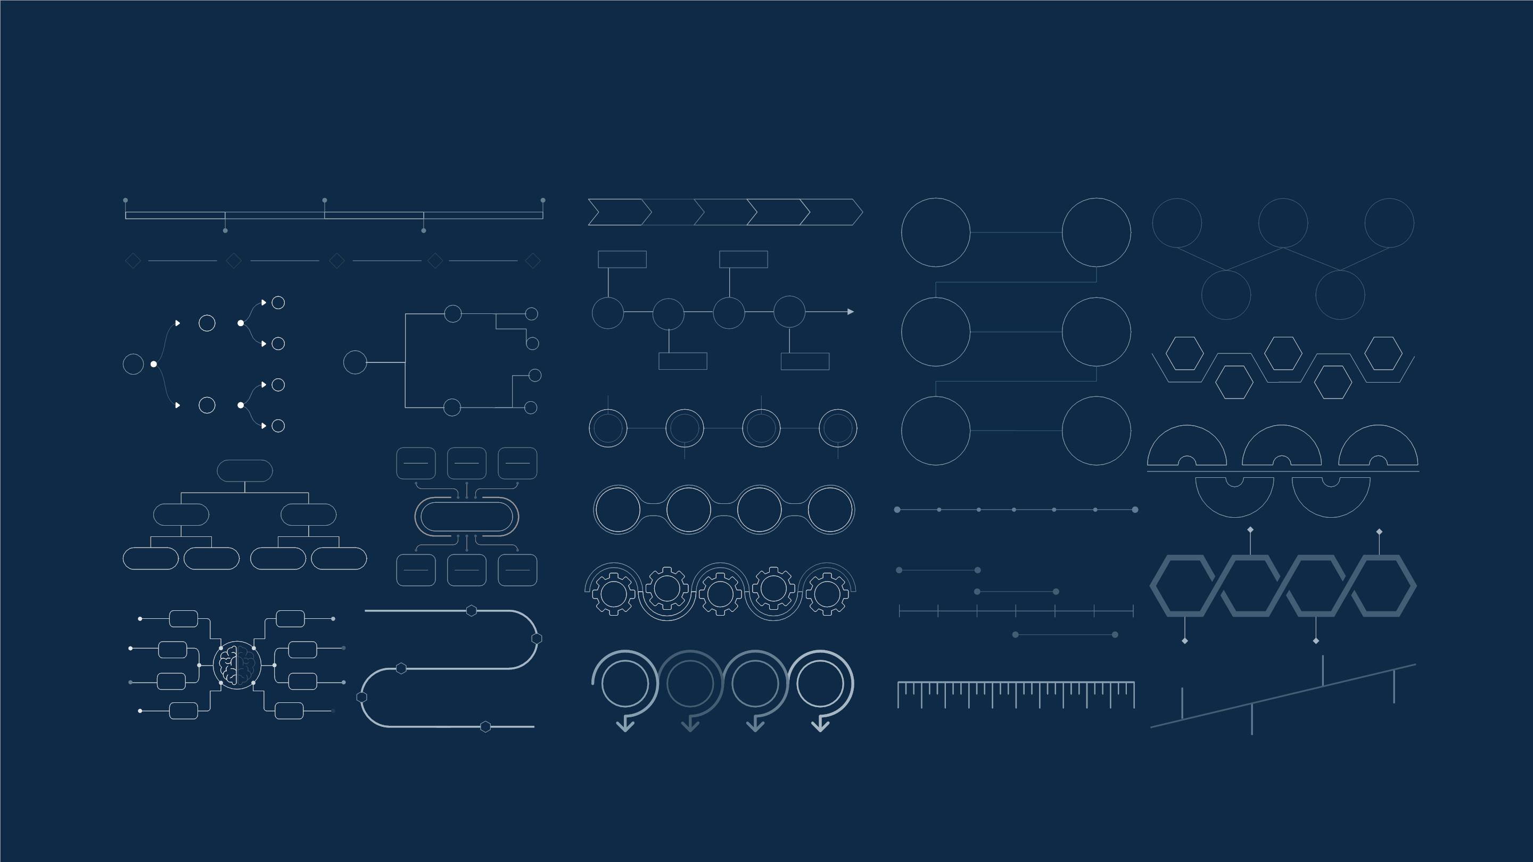

Slide 40

JANUARY
FEBRUARY
MARCH
APRIL
MAY
JUNE
PHASE 1
Task 1
Task 2
PHASE 2
Task 1
Task 2
JANUARY
FEBRUARY
MARCH
APRIL
PHASE 1
Task 1
Task 2

Slide 41


Slide 42


Slide 43

...and our sets of editable icons
You can resize these icons without losing quality.
You can change the stroke and fill color; just select the icon and click on the paint bucket/pen.
In Google Slides, you can also use Flaticon’s extension, allowing you to customize and add even more icons.

Slide 44

Educational Icons
Medical Icons

Slide 45

Business Icons
Teamwork Icons

Slide 46

Help & Support Icons
Avatar Icons

Slide 47

Creative Process Icons Performing Arts Icons

Slide 48

Nature Icons

Slide 49

SEO & Marketing Icons

Slide 50


